Slide 1
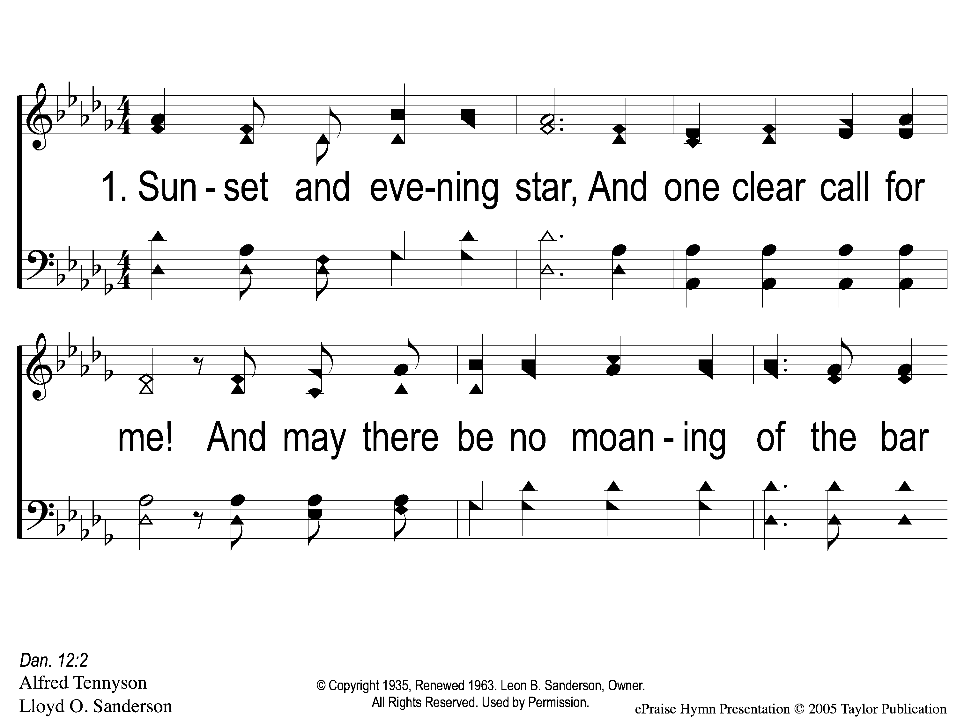
1-1 Crossing the Bar
Crossing the Bar
28
ePraise Hymn Presentation © 2005 Taylor Publications

Slide 2
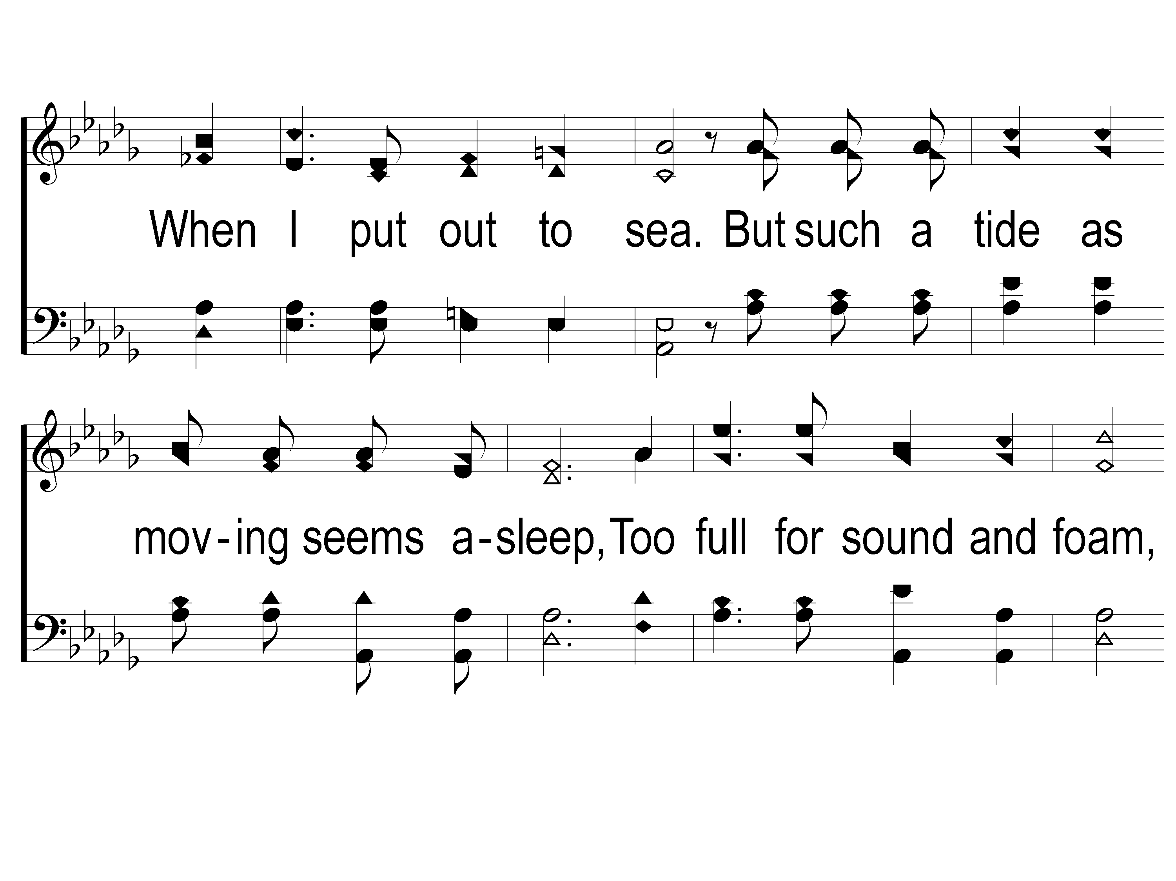
1-2 Crossing the Bar
Crossing the Bar
28
ePraise Hymn Presentation © 2005 Taylor Publications
ePraise Hymn Presentation ©2005 by Taylor Publications

Slide 3
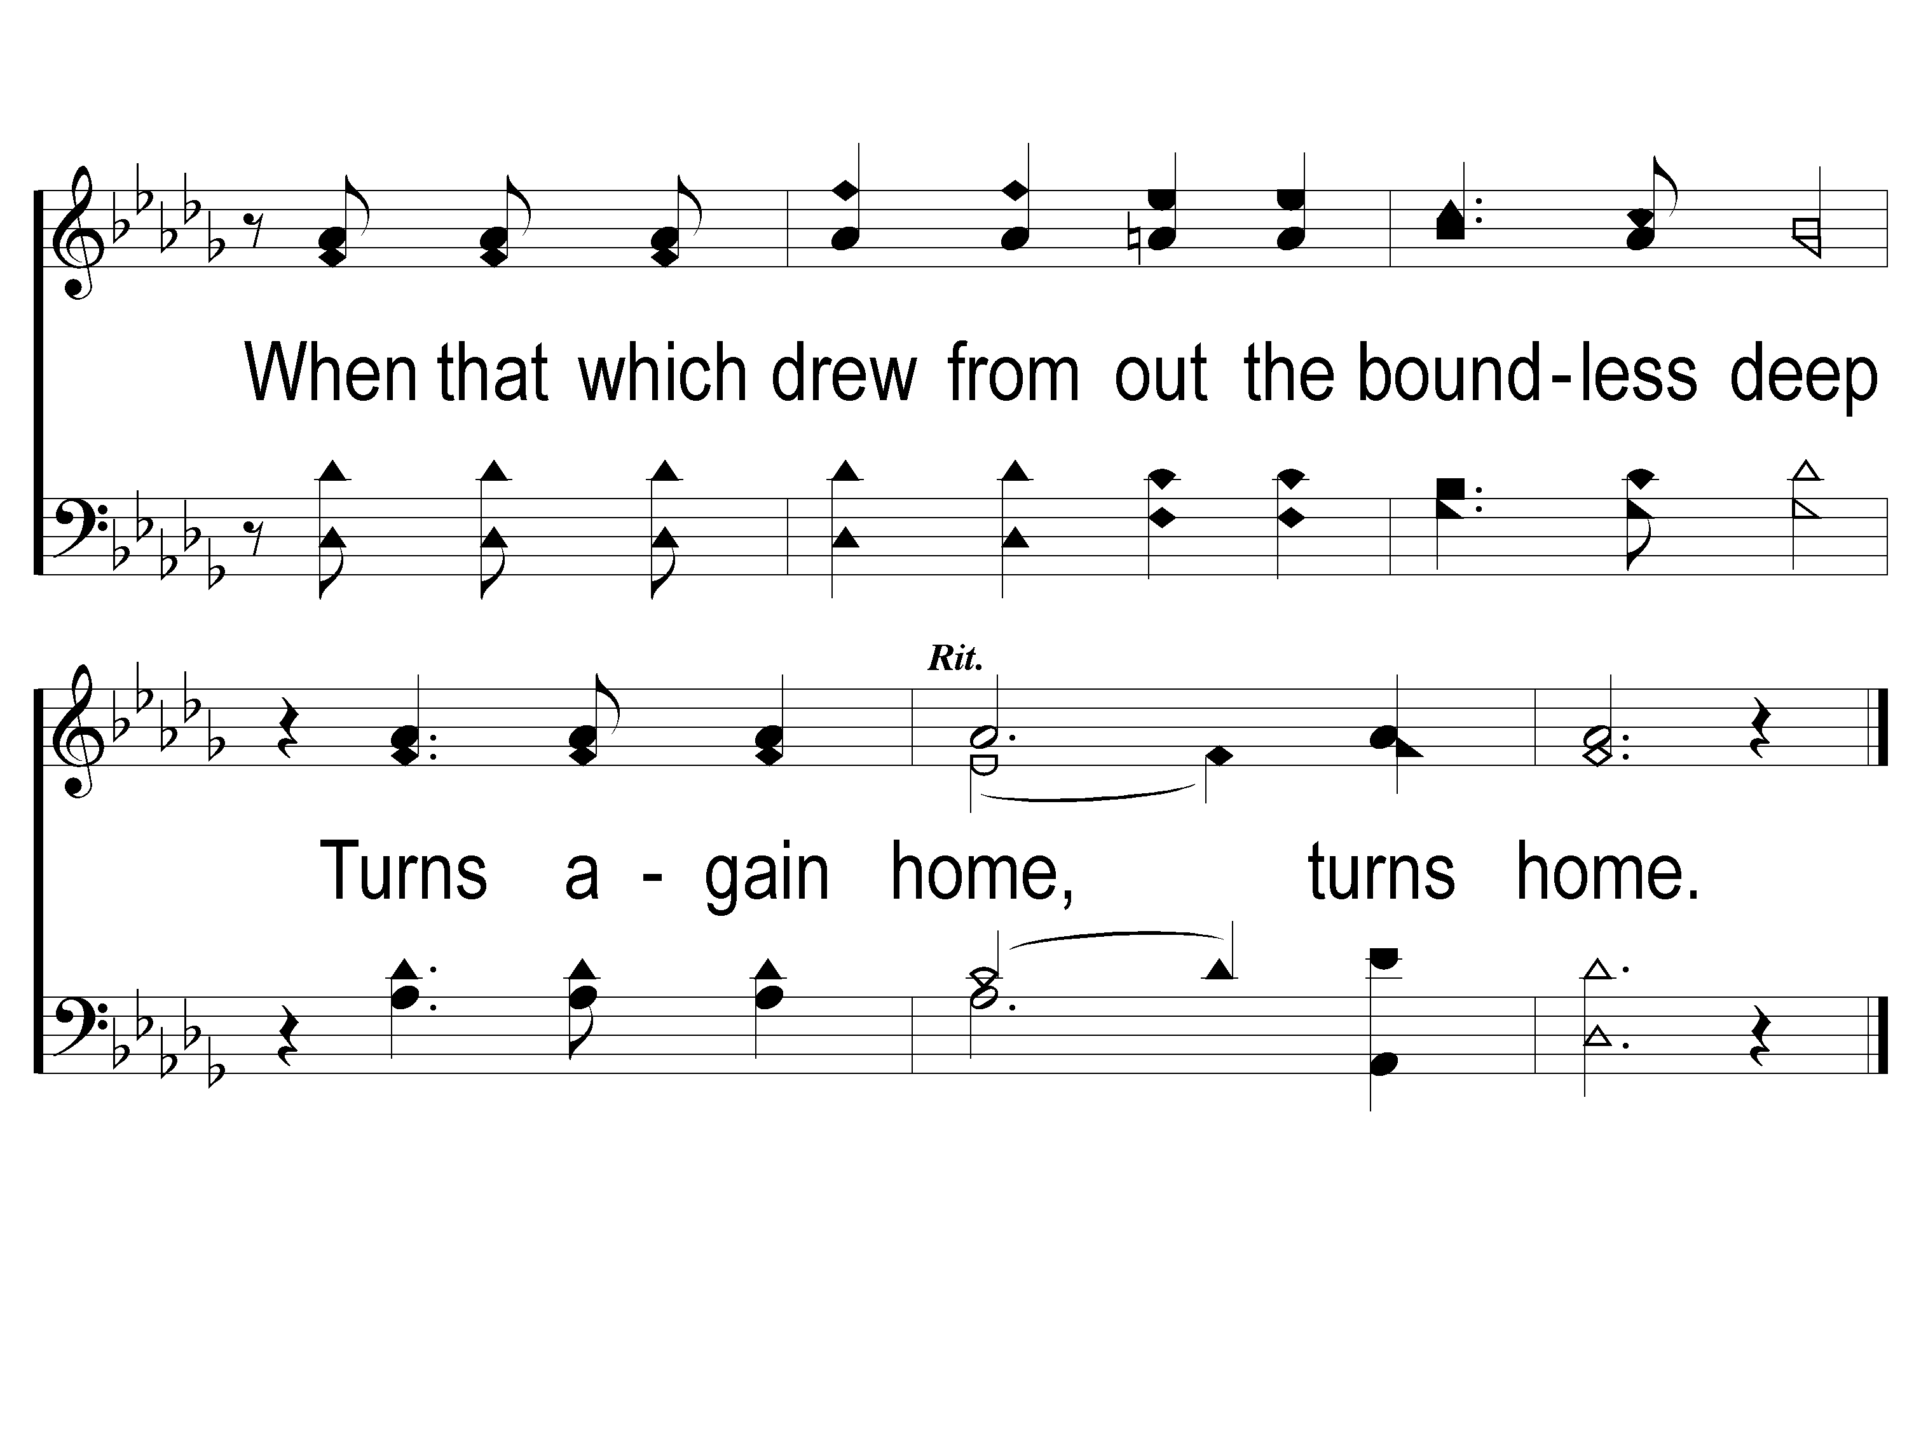
1-3 Crossing the Bar
Crossing the Bar
28
ePraise Hymn Presentation © 2005 Taylor Publications
ePraise Hymn Presentation ©2005 by Taylor Publications

Slide 4
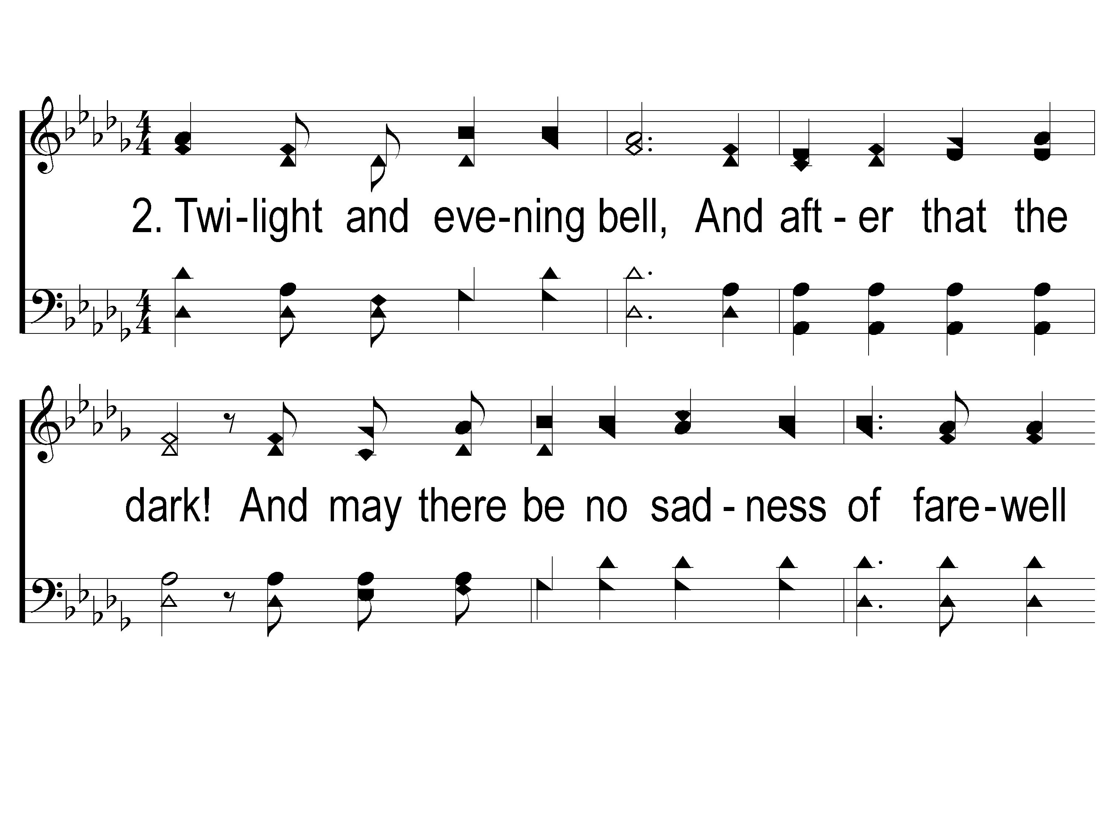
2-1 Crossing the Bar
Crossing the Bar
28
ePraise Hymn Presentation © 2005 Taylor Publications
ePraise Hymn Presentation ©2005 by Taylor Publications

Slide 5
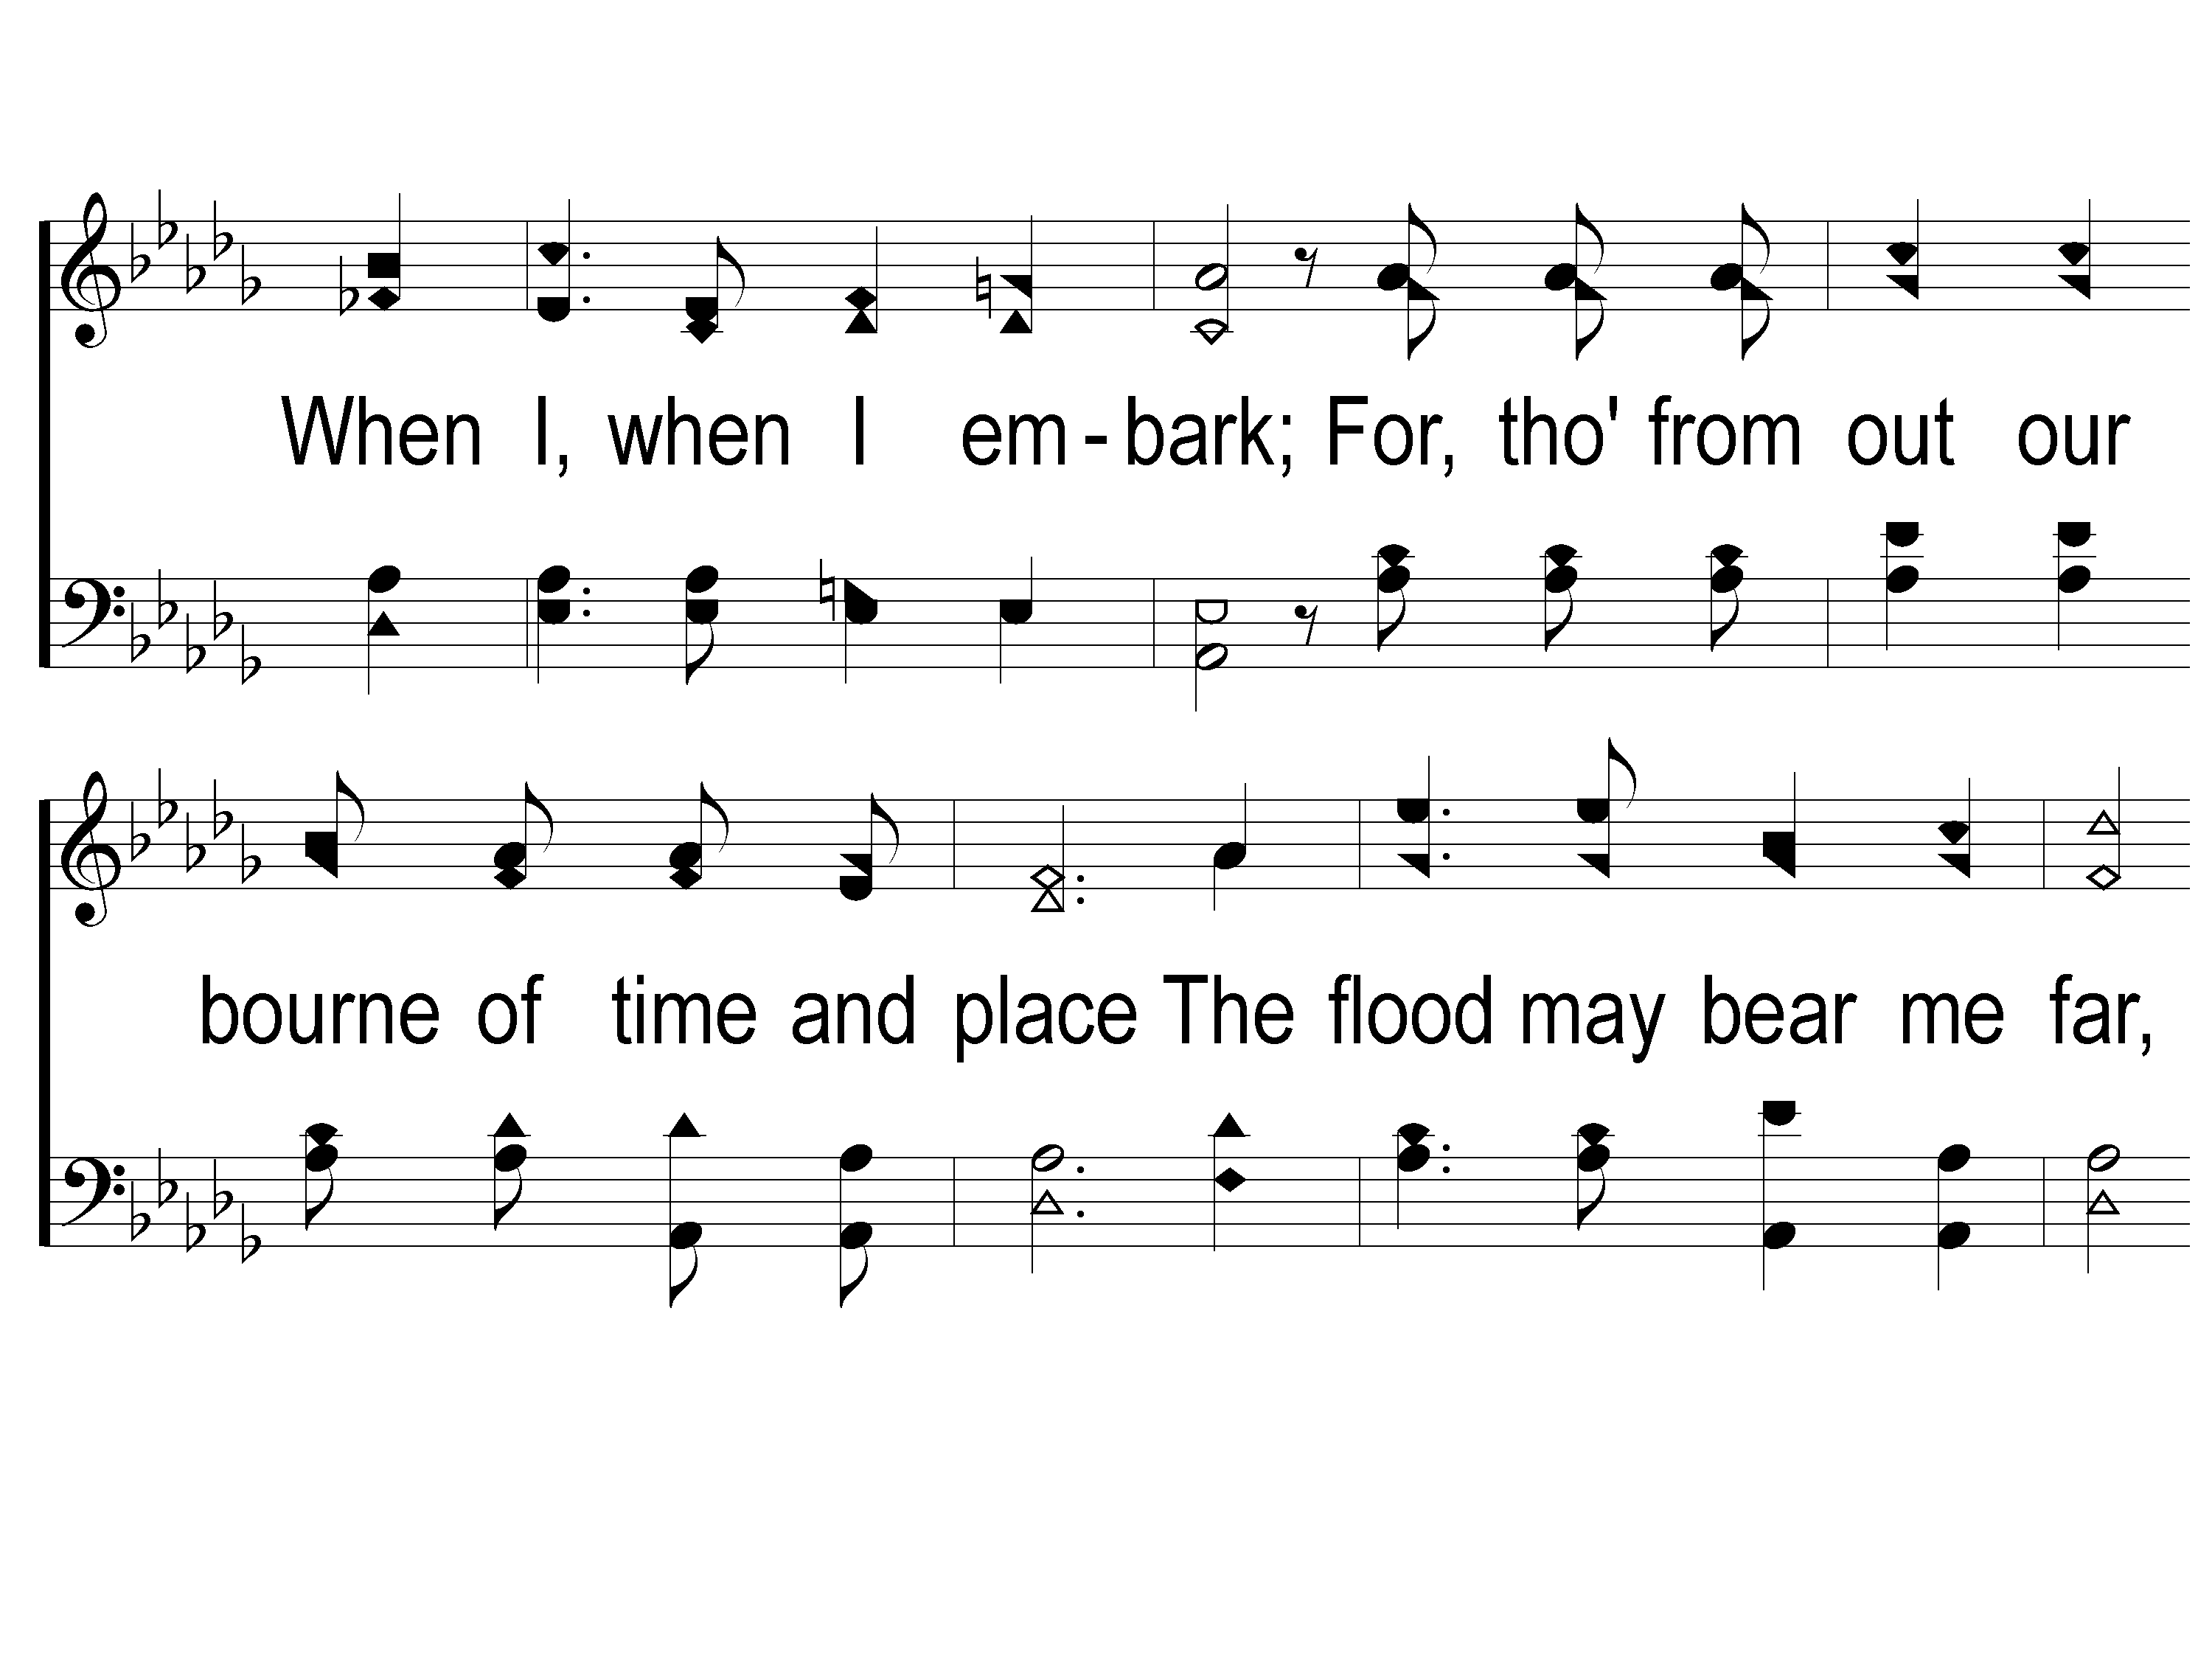
2-2 Crossing the Bar
Crossing the Bar
28
ePraise Hymn Presentation © 2005 Taylor Publications
ePraise Hymn Presentation ©2005 by Taylor Publications

Slide 6
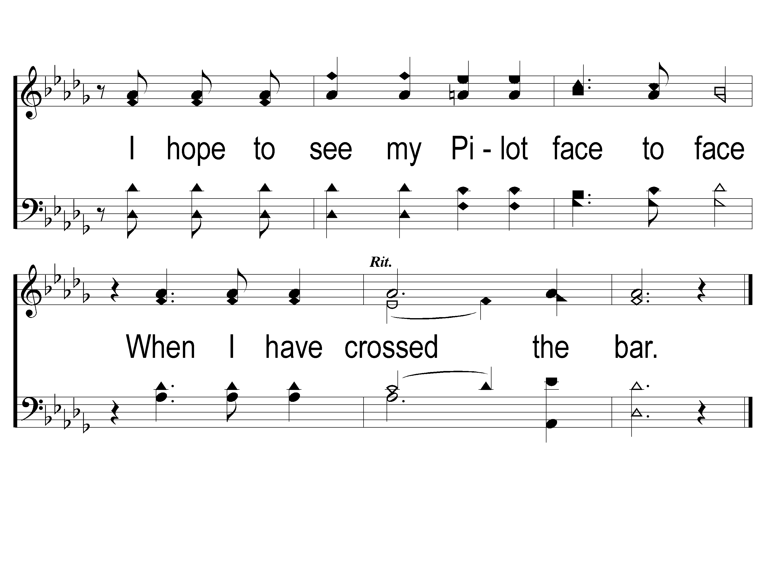
2-3 Crossing the Bar
Crossing the Bar
28
ePraise Hymn Presentation © 2005 Taylor Publications
ePraise Hymn Presentation ©2005 by Taylor Publications

